Slide 1
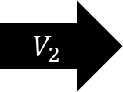

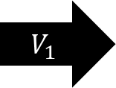



$${\hat{n}}_{1}$$
$${\hat{n}}_{2}$$
$$V_{1}$$
$$V_{2}$$
$$A_{2}$$
$$A_{1}$$

